Slide 1

Chittagong University of Engineering and Technology Department of Electrical and Electronic Engineering EEE 476 : VLSI Technology Sessional Presentation on 4 to 2 bit Binary Encoder
Prepared by
Abrar Adib(1802019)
&
Mashrife Jaman Radib(1802007)

Slide 2
Objectives
To create schematic of 2 input OR gate
To create schematic of 4 to 2 Bit binary encoder
To create symbol of 4 to 2 Bit binary encoder
To show output of schematic of 4 to 2 Bit binary encoder
To create layout of 4 to 2 Bit binary encoder
To clear all design rule errors and layout to schematic verification

Slide 3
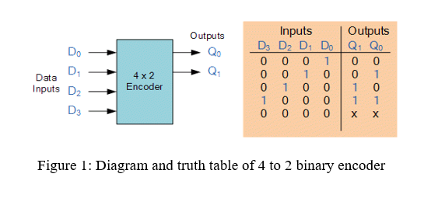
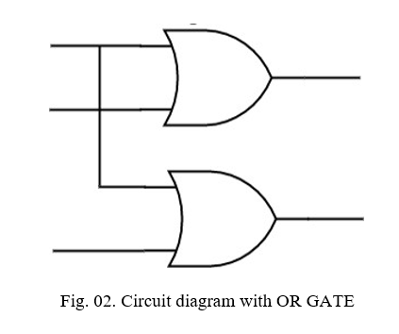
Introduction
The 4-to-2 Encoder comprises four input lines, namely D3, D2, D1, and D0, along with two outputs Q1 and Q0. The block diagram representing this encoder is depicted in the figure below. For each given instance, only one of the four inputs can have a value of '1' to obtain the corresponding binary code at the output. The Truth table for the 4-to-2 encoder is provided as follows. From Truth table
Q0=D1+D3
Q1=D2+D3

Slide 4
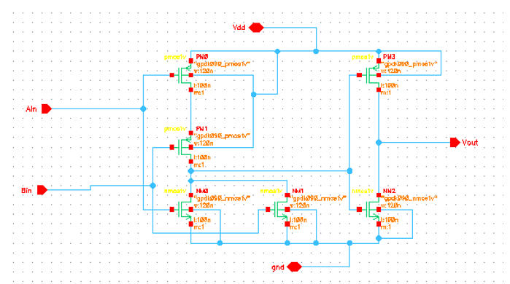
Schematic design of single OR gate

Slide 5
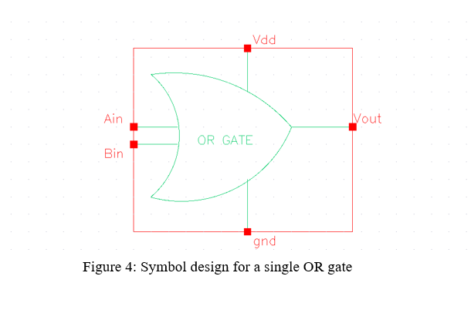
Symbol design for a single OR gate

Slide 6
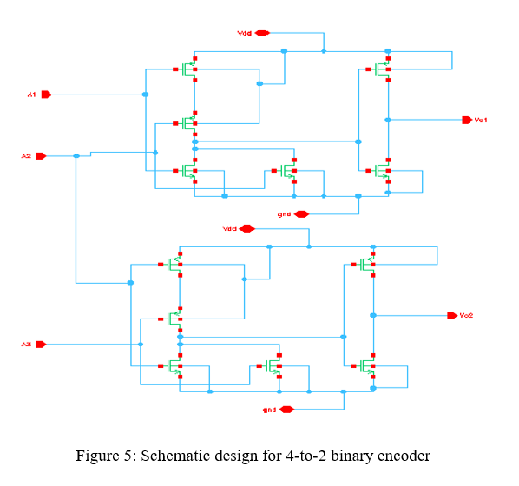
Schematic design for 4 to 2 binary encoder

Slide 7
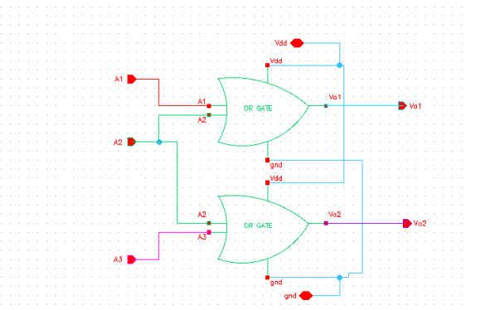
Symbol design for 4 to 2 binary encoder
Schematic design for 4-to-2 binary encoder
Symbol design for 4-to-2 binary encoder

Slide 8
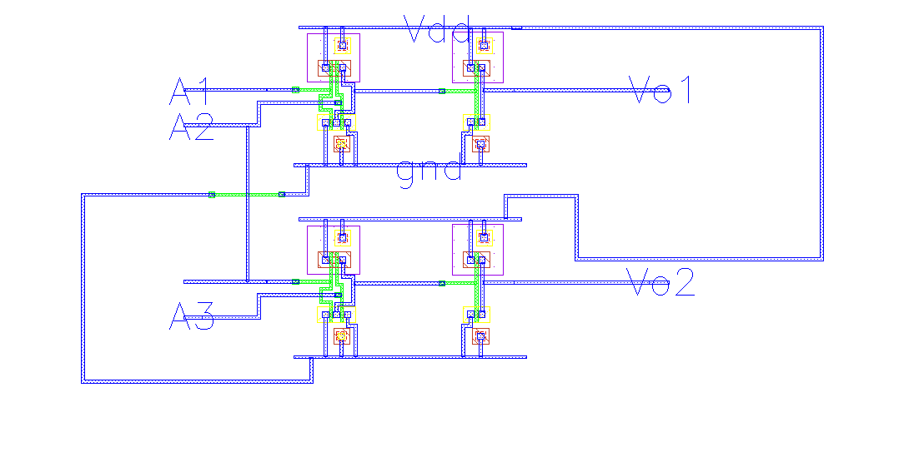
4 to 2 Binary Encoder Layout
4 to 2 Binary Encoder Layout

Slide 9
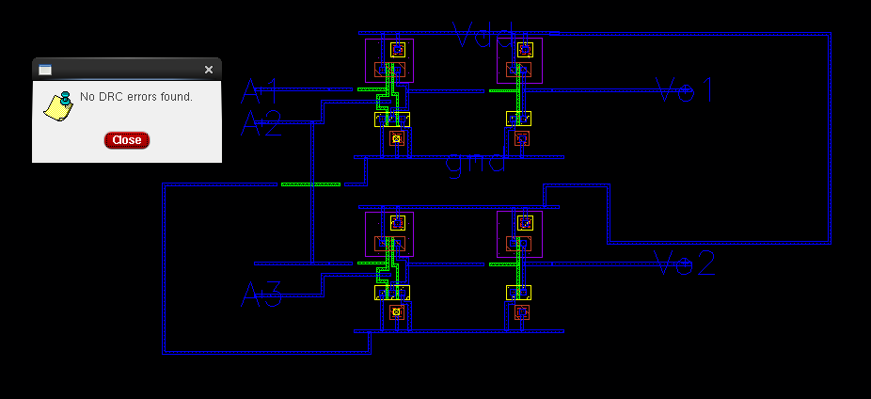
DRC Test

Slide 10
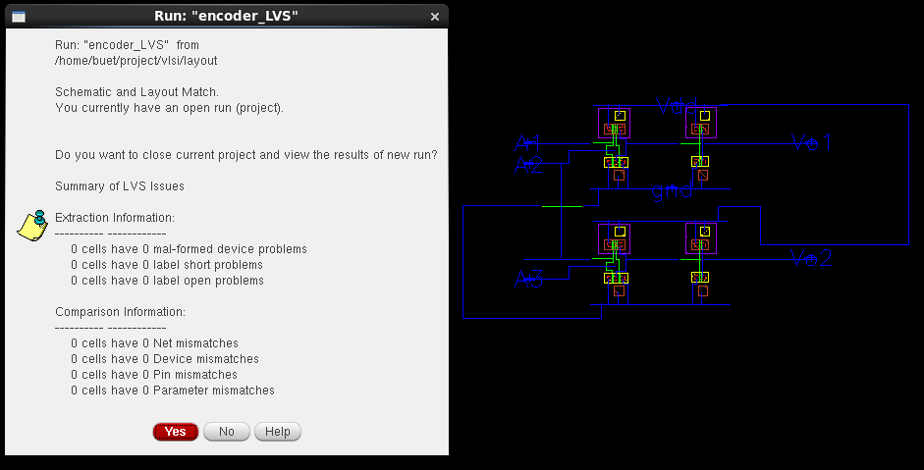
LVS Test

Slide 11
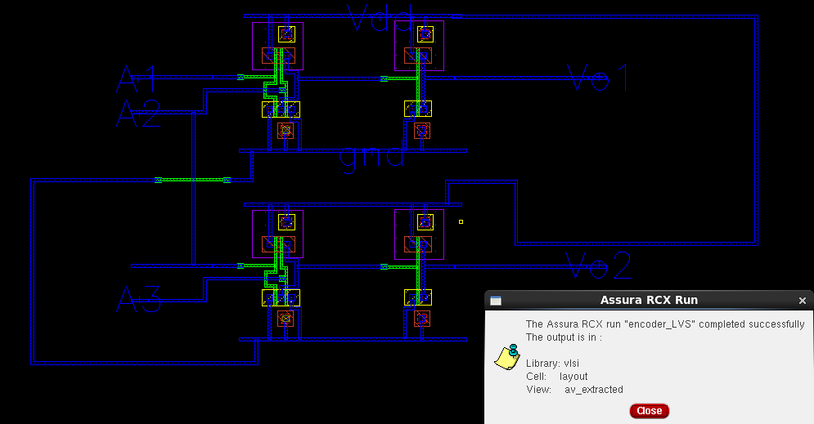
RCX Run

Slide 12
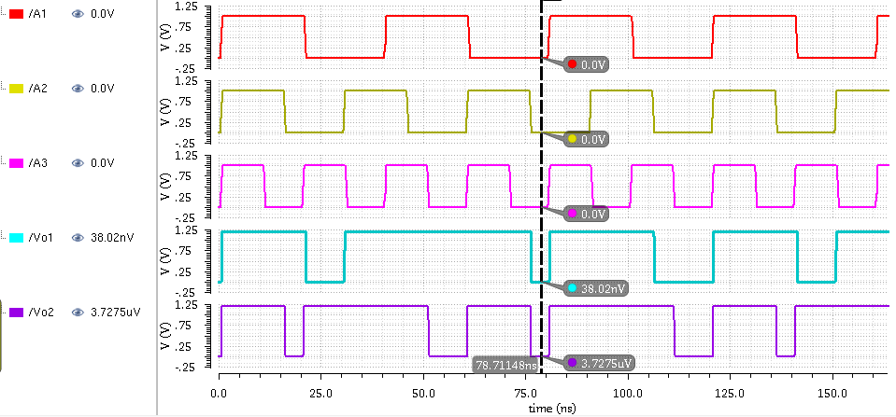
Simulation Results
ii. Simulated Result:
Case 1:
When Inputs are,
A1=0, A2=0 & A3=0
Theoretical Result:
Vo1= 0, Vo2= 0.

Slide 13
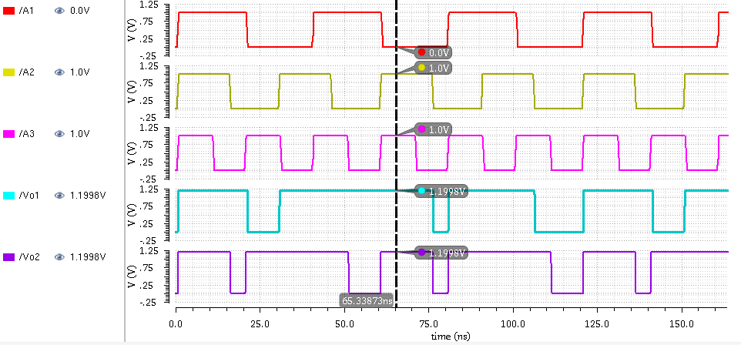
Simulation Results
ii. Simulated Result:
Case 2:
When Inputs are,
A1=0, A2=1 & A3=1
Theoretical Result:
Vo1= 1, Vo2= 1.

Slide 14
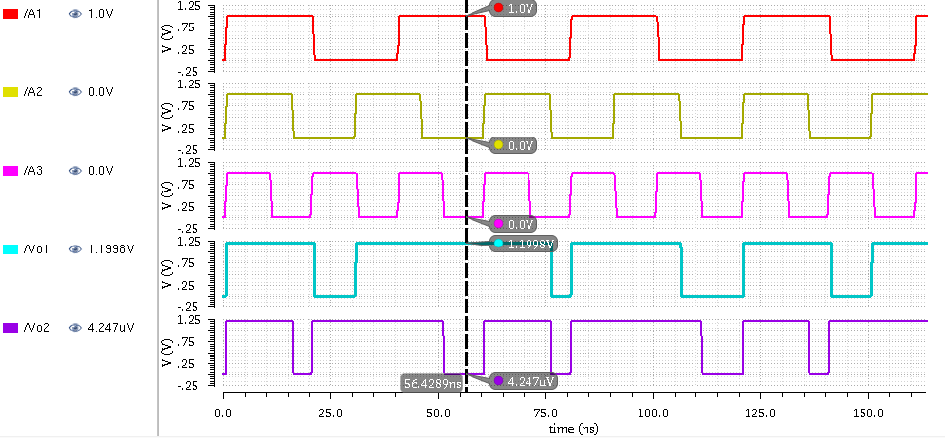
Simulation Results
ii. Simulated Result:
Case 3:
When Inputs are,
A1=1, A2=0 & A3=0
Theoretical Result:
Vo1= 1, Vo2= 0.

Slide 15
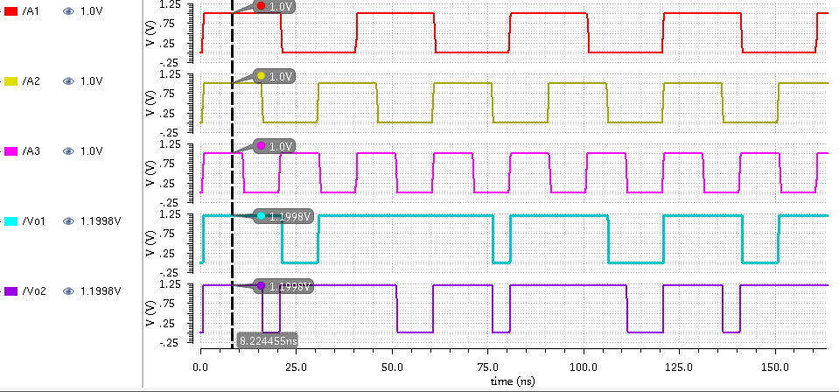
Simulation Results
ii. Simulated Result:
Case 4:
When Inputs are,
A1=1, A2=1 & A3=1
Theoretical Result:
Vo1= 1, Vo2= 1.

Slide 16
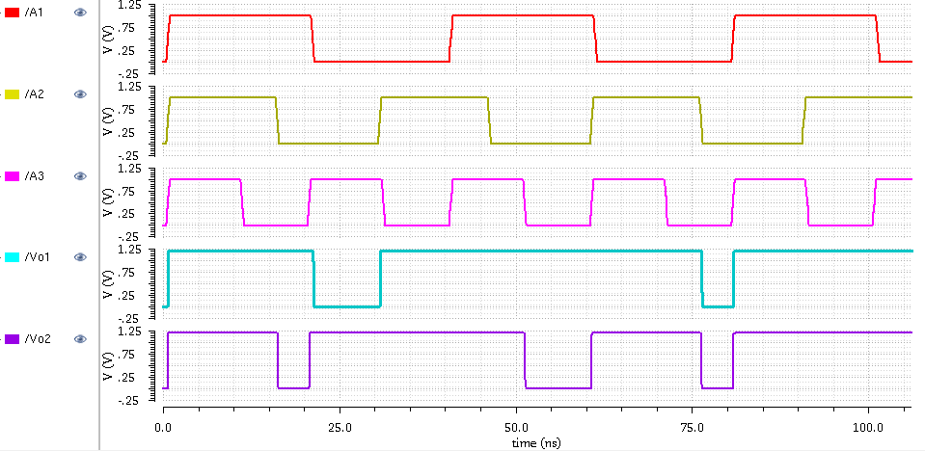
Post Simulation Output
Post Simulation Output

Slide 17
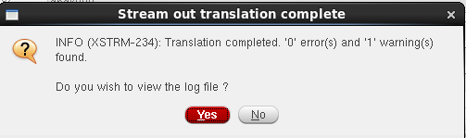
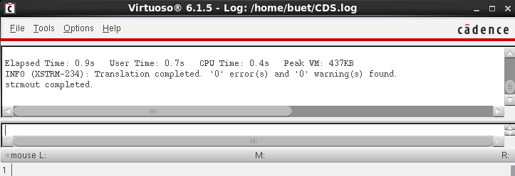
Tape Out
Tape Out

Slide 18
Conclusion
During this project, we gained proficiency in using Cadence Software. We successfully created the schematic for a 4-to-2 binary encoder, incorporating a 2-input OR gate. Additionally, we completed the corresponding Layout design. To ensure the design's correctness, we performed Design Rule Check (DRC) and Layout Versus Schematic (LVS) verification, resolving any flagged errors in the process.

Slide 19


